Slide 1


SMS Reminder
By:
Wisam N. Abu Karsh
NID@L M. Alburbar

Slide 2
What’s Our Project do.
Where We From The Project.

Slide 3
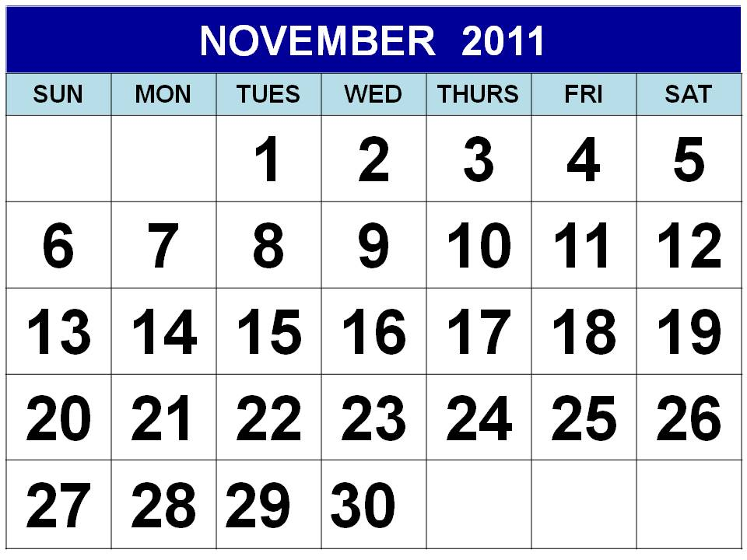
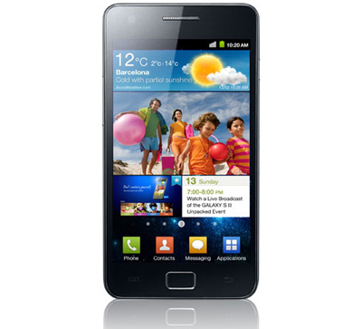

Even Name: Important Meeting
Date: 10-10-2012
Time From: 1:00 PM To: 2:00 PM
With: Wisam – NID@L – Ibrahim – Rasha
Message: Please Don’t Delay.

Slide 5


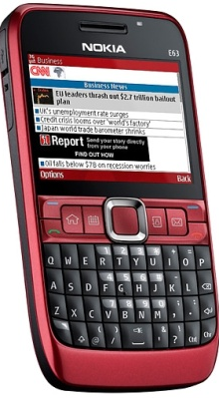
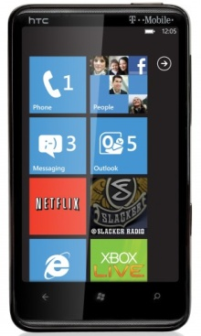

Even Name: Important Meeting
Date: 10-10-2012
Time From: 1:00 PM To: 2:00 PM
With: Wisam – NID@L – Ibrahim – Rasha
Message: Please Don’t Delay.
Ibrahim
NID@L
Rasha

Slide 6
Even Name: Important Meeting
Date: 10-10-2012
Time From: 1:00 PM To: 2:00 PM
With: Wisam – NID@L – Ibrahim – Rasha
Message: Please Don’t Delay.
Even Name: Important Meeting
Date: 10-10-2012
Time From: 1:00 PM To: 2:00 PM
With: Wisam – NID@L – Ibrahim – Rasha
Message: Please Don’t Delay.
Even Name: Important Meeting
Date: 10-10-2012
Time From: 1:00 PM To: 2:00 PM
With: Wisam – NID@L – Ibrahim – Rasha
Message: Please Don’t Delay.

Slide 7
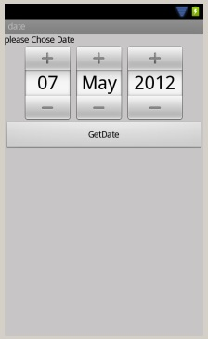
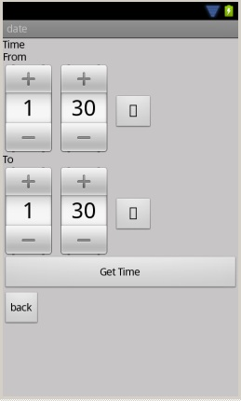
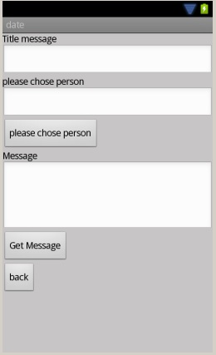
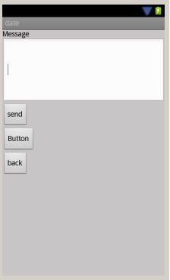
Where We From The Project:

Slide 8
Thank you
For
Listening
☺

